Slide 1
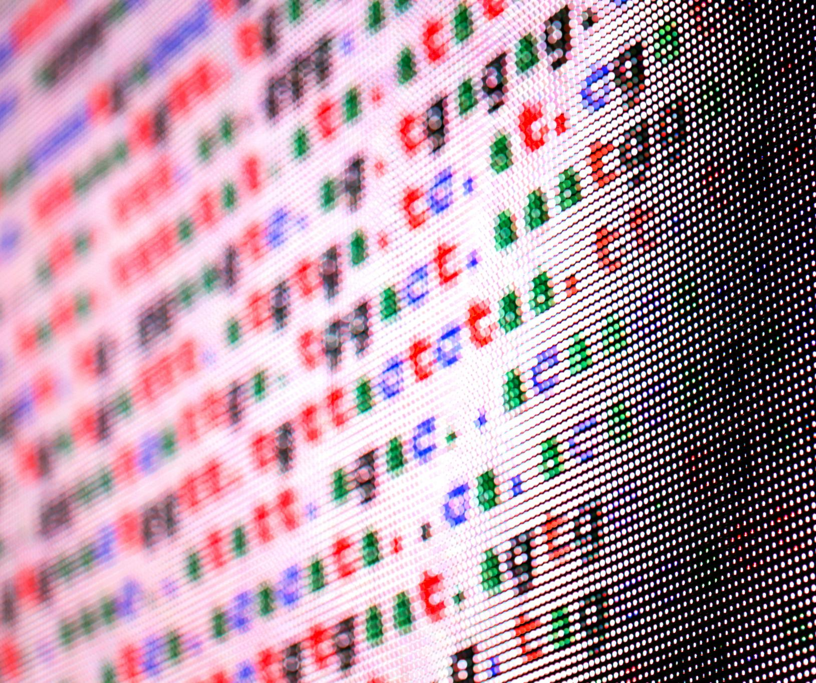
CIFAR-10 Supervised Machine Learning
Jayjit Pradhan
May, 2025

Slide 2

Agenda Items
Project & Problem Description
Data Description and Load
Data Clean-Up and EDA
Data Preprocessing
Model Build
Model Comparison
Summary

Slide 3

Project and Problem Description
As part of DTSA-5509 Introduction to Machine Learning course for Master of Science in Data Science from University of Colorado, Boulder, this project is done for classifying CIFAR-10 dataset using supervised machine learning algorithms
The CIFAR-10 dataset consists of 60000 32x32 color images in 10 classes, with 6000 images per class.
The classes are—
Airplane, Automobile, Ship, Truck
Bird, Cat, Deer, Dog, Frog, Horse

Slide 4
Data Description and Load

Slide 5
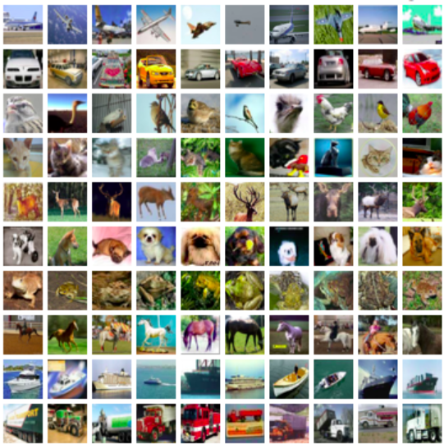
CIFAR-10 Dataset
Dataset Overview
CIFAR-10 consists of 60,000 images divided into 10 distinct classes for classification tasks.
Image Classes
Each class in the CIFAR-10 dataset contains 6,000 labeled images, facilitating robust training and testing of models. Each image in the CIFAR-10 dataset is 32x32 pixels in RGB format, making it suitable for various algorithms.
Benchmarking Tool
CIFAR-10 is widely used as a benchmark for evaluating machine learning algorithms in image classification tasks.
Keras Dataset
For this project CIFAR-10 dataset have been loaded from Keras Datasets.

Slide 6
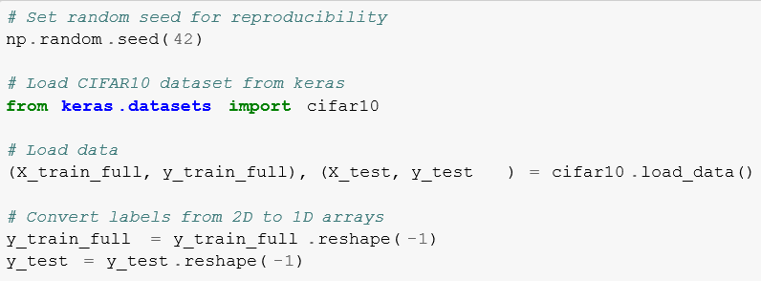
Loading CIFAR10 Dataset
Loading with Keras
To load CIFAR-10 dataset in Keras, I have used the function keras.datasets.cifar10.load_data().
Automatic Train-Test Split
This data load automatically splits the data in Train & Test batches of 50,000 & 10,000 images respectively.
Image Properties
Each image in the Train & test dataset is 32x32 pixels in RGB format, having a pixel value range from 0-255.

Slide 7
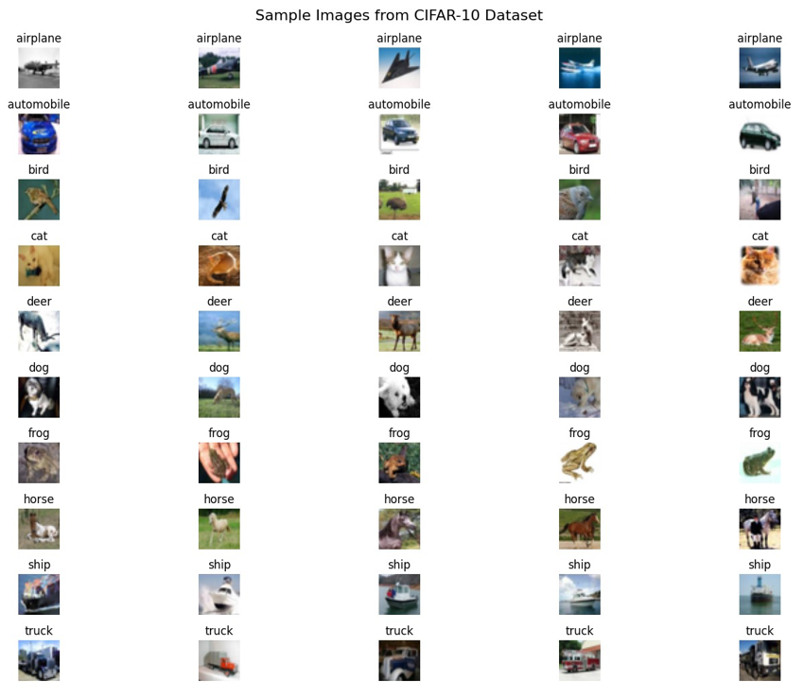
Sample Images from CIFAR-10

Slide 8
Data Clean-Up and EDA

Slide 9

Data Clean-up
No data clean-up are done on Keras CIFAR10 data as—
Pre-curated Dataset
CIFAR-10 is a well-established, carefully curated benchmark dataset that has already undergone quality control. Unlike real-world datasets, it doesn’t contain: Missing values, Corrupted images, Mislabeled samples or Inconsistent formatting
Uniform Image Properties
Each image in the Train & test dataset is 32x32 pixels in RGB format, having a pixel value range from 0-255.
Balanced Classes
CIFAR-10 has exactly 6,000 images per class (balanced distribution), so no class imbalance handling was required.
Nature of Image Data
Unlike tabular data, images typically don’t have issues like Outliers, Categorical value encoding, Date/time field conversions etc.

Slide 10
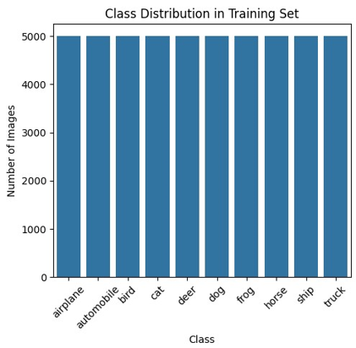
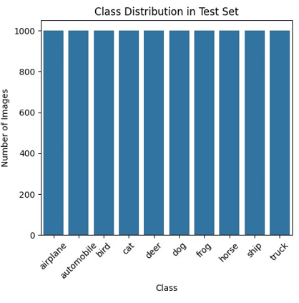
Class Distribution in CIFAR-10
Understanding the distribution of classes is crucial for model training.
Each class in CIFAR-10 contains 6,000 images. 5000 images in training set and 1000 images in test set.
Balance in class distribution helps in benchmarking model performance.

Slide 11
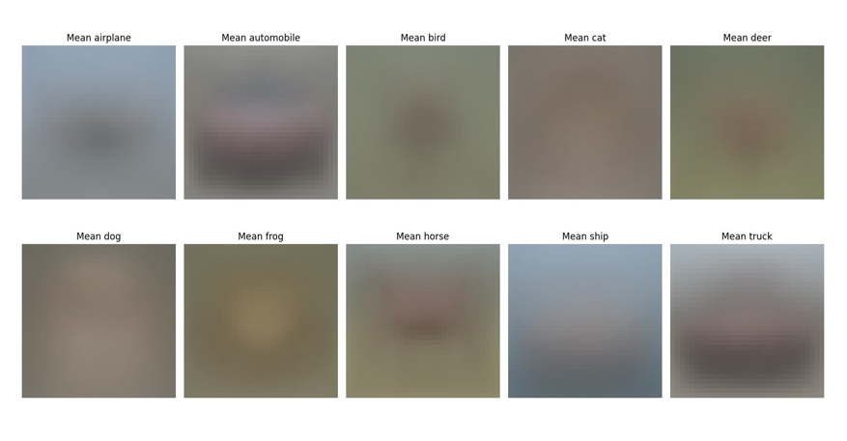
Visualizing Mean Images
Visualizing mean images per class highlights common features.
Mean images are computed by averaging pixel values.
Useful for identifying class-specific characteristics such as—
Mean airplane/ship images show a distinctive cruciform shape on a blue background
Mean automobile/truck images reveal horizontal shapes with visible wheel positions
Mean animal images (cats, dogs, deer) show basic body outlines with common postures –
The frog mean image typically shows a top-down view with a distinctive silhouette

Slide 12
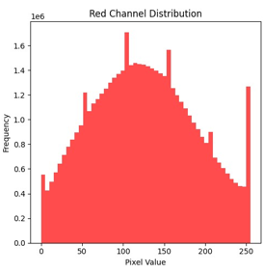
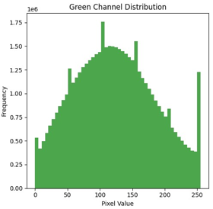
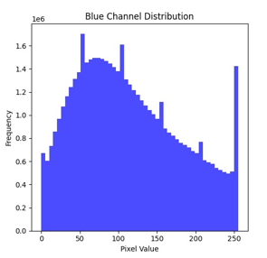
Pixel Value Distribution Analysis
Pixel values range from 0 to 255 in RGB images.
Understanding pixel value distribution aids in normalization.
Visual inspection show all the RGB channels have similar pixel value distribution.

Slide 13
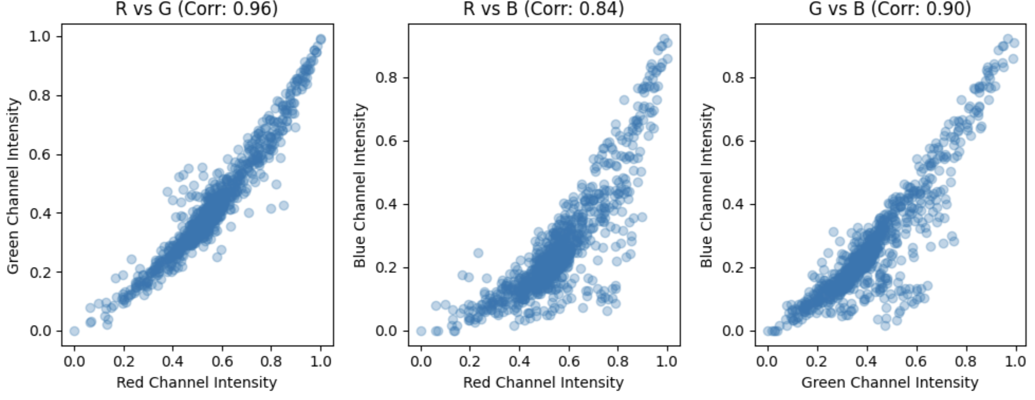
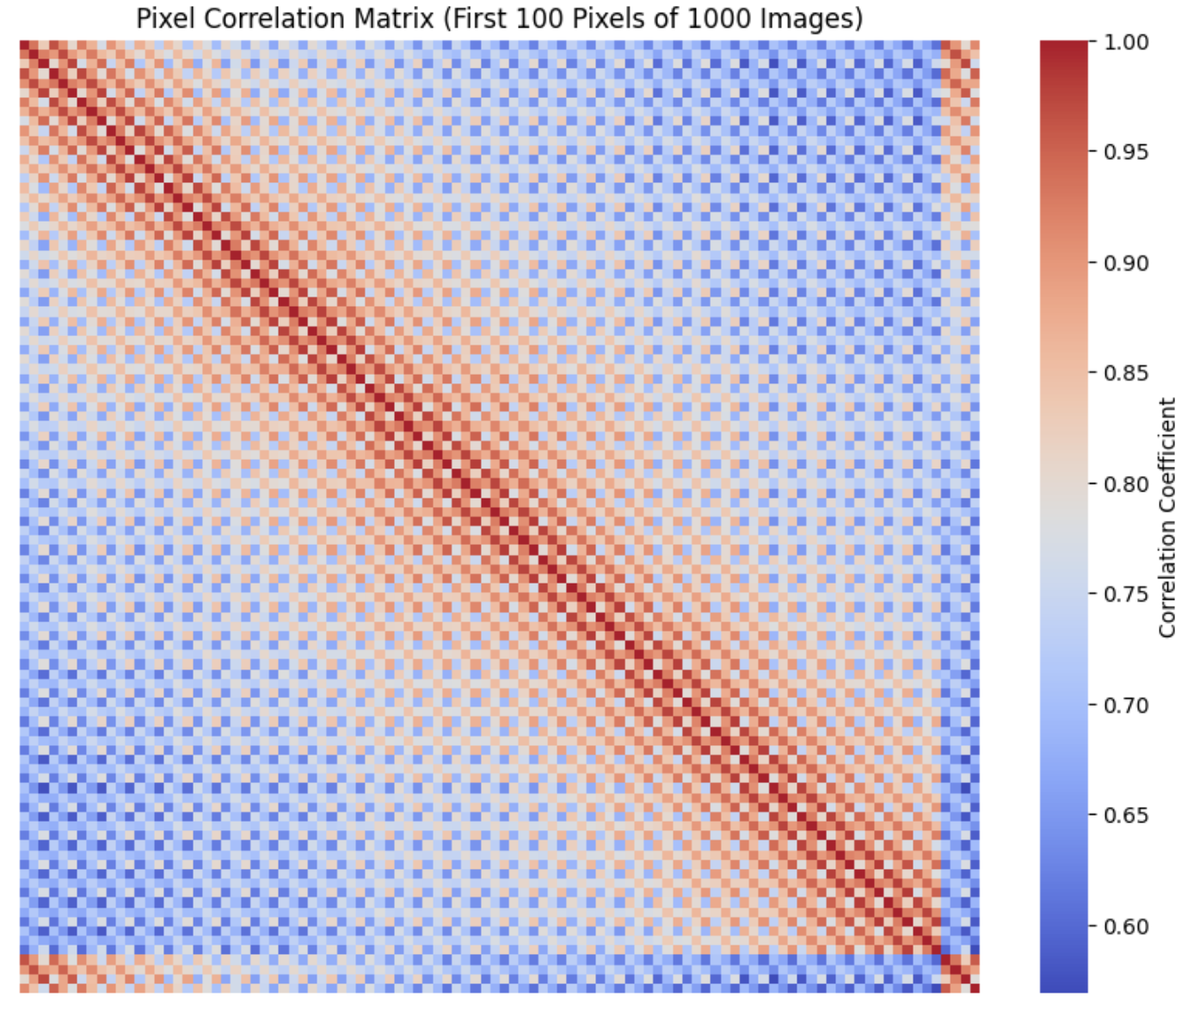
Pixel Value Correlation Analysis
High positive correlation between color channels suggest that the intensity values in these channels tend to vary together.
High positive correlation between nearby pixels is expected because neighboring pixels in an image often have similar color intensities.
Low correlation between distant pixels is also seen.

Slide 14
Data Preprocessing

Slide 15
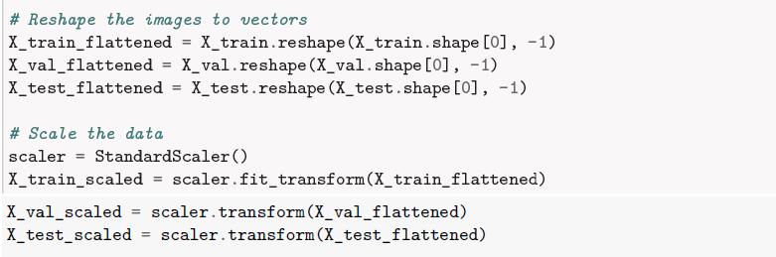
Flattening & Scaling the Data
Flattening transforms multi-dimensional arrays into one-dimensional arrays.
Scaling normalizes data to a common range. Using StandardScaler() package this is done.
Improves convergence speed in training algorithms.

Slide 16
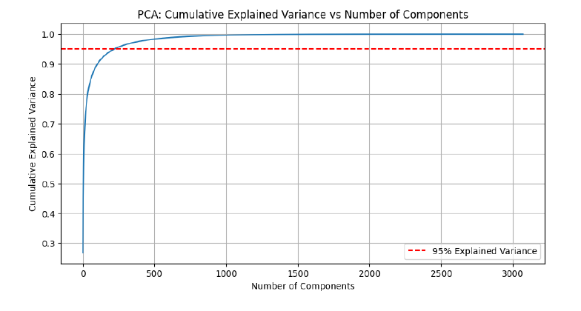
Dimensionality Reduction with PCA
PCA reduces the number of features while retaining variance.
Helps in visualizing high-dimensional data.
Aids in reducing overfitting in models.
Using 95% explain variance, number of features are reduced from 3072 to 220.

Slide 17
Model Build

Slide 18
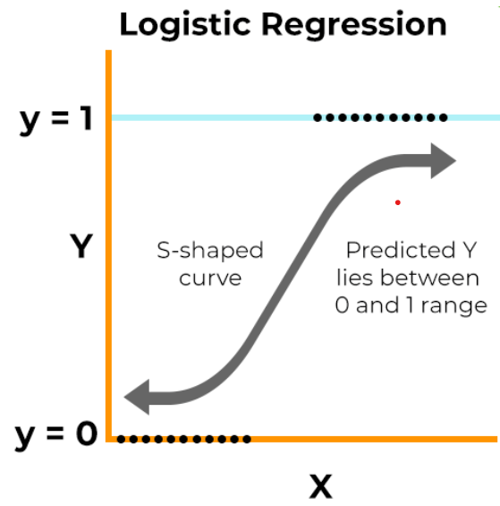
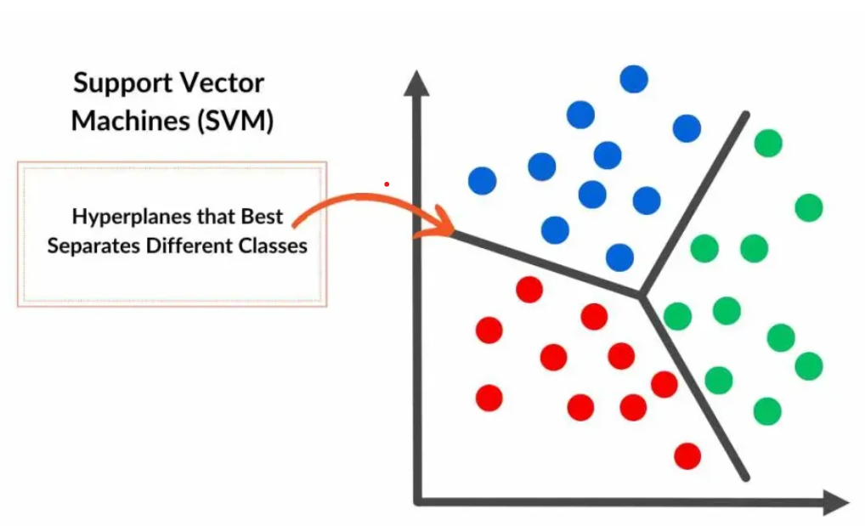
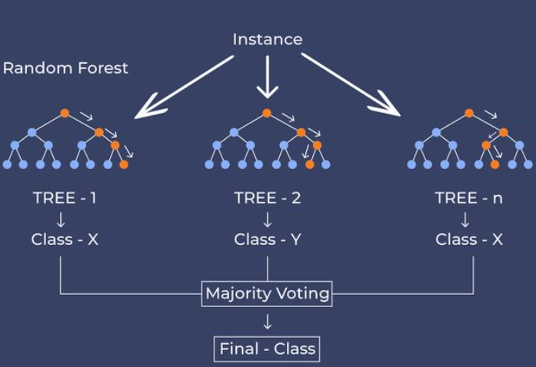
Choice of Algorithms
Logistic Regression
Logistic regression captures basic patterns in image data. It offers interpretability and computational efficiency, making it valuable for establishing initial performance metrics.
It also provides a good reference point to evaluate the performance gain from more complex models.
Support Vector Machines (SVM)
SVMs excel at finding optimal decision boundaries in high-dimensional spaces, making them particularly effective for image classification tasks like CIFAR-10. With appropriate kernel functions, they can model complex non-linear relationships in the data.
SVMs are also less prone to overfitting when properly regularized, and they perform well even with a limited number of training examples per class
Random Forest Classifier
Random Forest is well-suited for CIFAR-10 because it handles the high-dimensional nature of image data effectively. Its ensemble approach combines multiple decision trees to reduce overfitting while capturing complex, non-linear relationships in the data.
Random forests are also robust to outliers and noise, which is beneficial when working with diverse image categories. Additionally, they provide feature importance rankings that can offer insights into which aspects of the images are most discriminative for classification

Slide 19

Training & Validating Models
Hyperparameter Tuning
Using GridSearchCV package hyperparameter tuning is done for selected algorithms.
Training Models
With hyperparameter tuned parameters, models are trained with training image data set.
Performance Matrix
Accuracy score provides a fair and straightforward assessment of the model’s performances since all classes contribute equally to the performance metric, without biasing results toward any class.
Validating Models
Using 20% of training data as Validation set, model’s performances are measured.

Slide 20
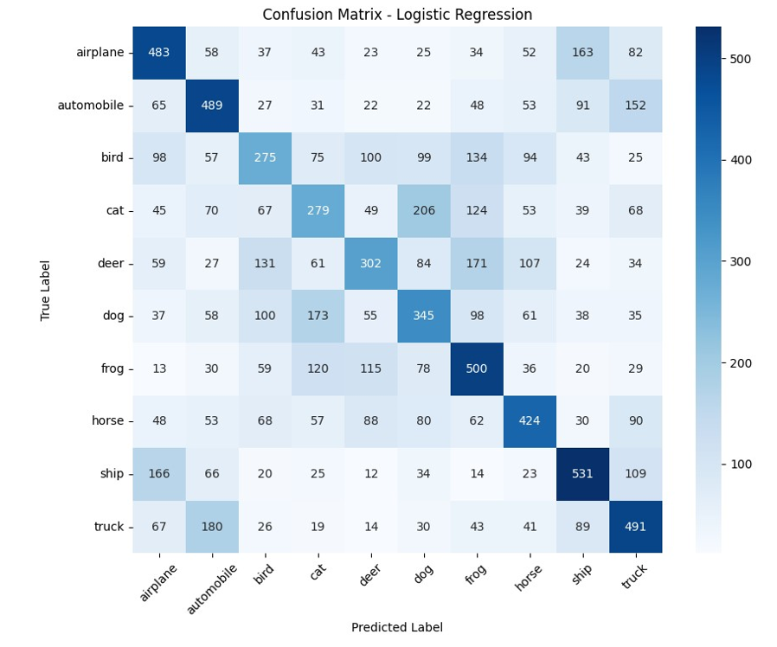
Logistic Regression
Hyperparameter Tuned Model
Logistic Regression model created with hyperparameters as ['C': 0.1, 'max_iter': 500, 'solver':'lbfgs’] with a CV accuracy_score of 0.40.
Validation Accuracy
The accuracy in the validation set is 0.41 suggesting a generalized model.
Confusion Matrix
Confusion Matrix show model was most confused between cat & dog images followed by truck & automobile and ship & airplane.

Slide 21
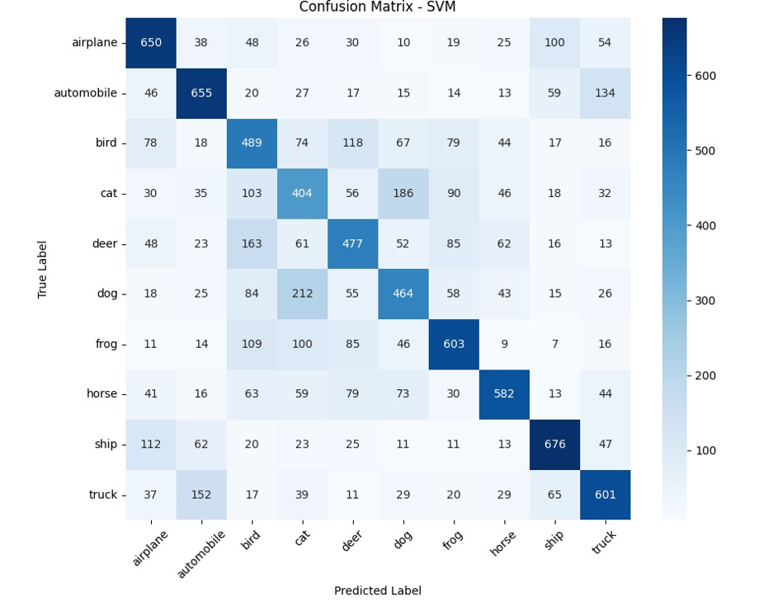
Support Vector Machines (SVM)
Hyperparameter Tuned Model
SVM model created with hyperparameters as ['C': 10, 'gamma': 'scale', 'kernel': 'rbf'] with a CV accuracy_score of 0.53
Validation Accuracy
The accuracy in the validation set is 0.56 suggesting better performance on unseen data.
Confusion Matrix
Confusion Matrix show model was most confused between cat & dog images followed by truck & automobile and ship & airplane.

Slide 22
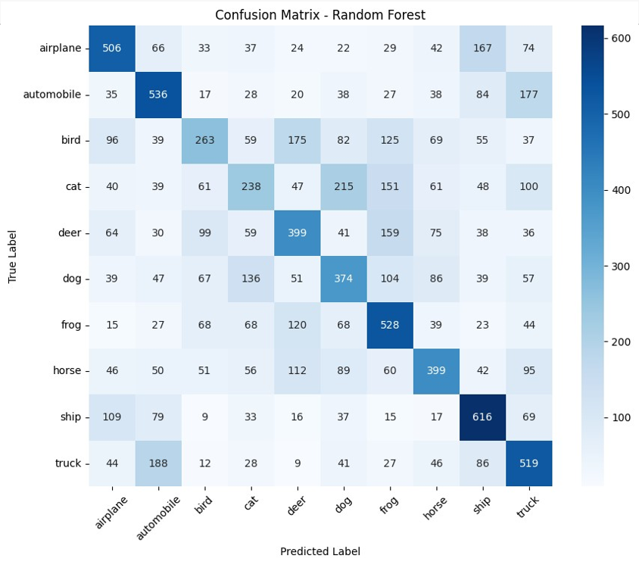
Random Forest Classifier
Hyperparameter Tuned Model
Random Forest model created with hyperparameters as ['max_depth': 20, 'min_samples_split': 5, 'n_estimators': 100] with a CV accuracy_score of 0.42.
Validation Accuracy
The accuracy in the validation set is 0.44 suggesting a generalized model.
Confusion Matrix
Confusion Matrix show model was most confused between cat & dog images followed by truck & automobile and bird & deer.

Slide 23
Model Compare

Slide 24
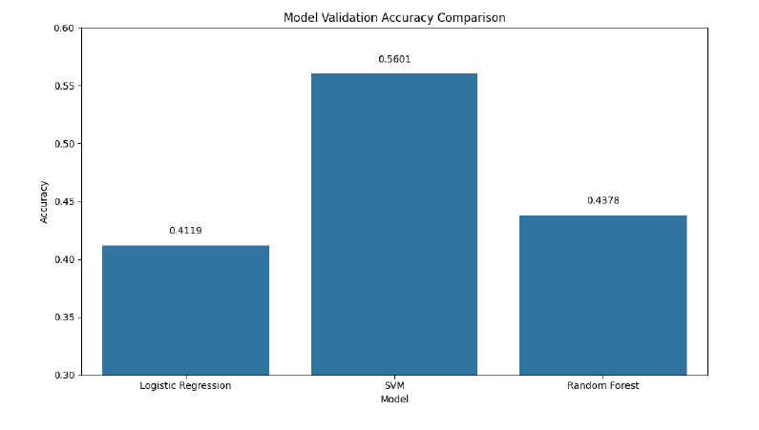
Comparing Model Performances
Evaluation Metrics
Using Accuracy score in validation set model performance is compared.
Visualizing Results
Looking at the results it is evident that SVM performed the best with validation accuracy as 0.5601.

Slide 25
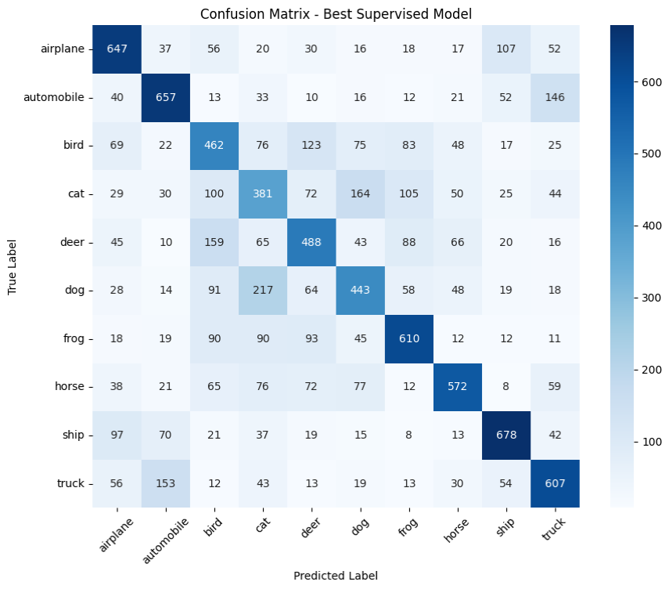
Best Model Validation on Test set
Accuracy Score
With the test set hyperparameter tuned SVM model gave accuracy_score of 0.56 suggesting no overfitting or underfitting.
Confusion Matrix
Confusion Matrix shows model is most confused between cat & dog images followed by truck & automobile and bird & deer.

Slide 26
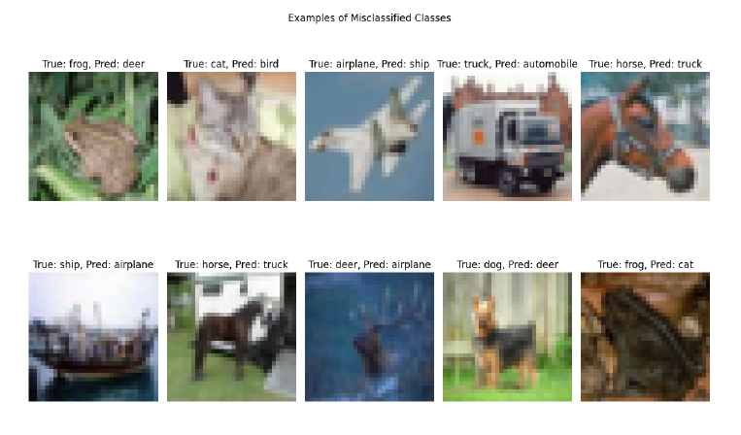
Misclassified Samples

Slide 27
Summary

Slide 28

Analysis of Model Performance
Logistic Regression
Strengths: Simple, interpretable, fast to train
Weaknesses: Less powerful for capturing complex patterns in image data
Support Vector Machines
Strengths: Powerful for high-dimensional data, effective with the kernel trick
Weaknesses: Computationally intensive to train, harder to interpret
Random Forest
Strengths: Handles nonlinear data well, less prone to overfitting, provides feature importance
Weaknesses: Less interpretable than simpler models, can be memory-intensive

Slide 29

Future Work and Improvements
Feature Engineering
Extract more sophisticated features like HOG (Histogram of Oriented Gradients)
Use more advanced dimensionality reduction techniques like t-SNE
Ensemble Methods
Create a weighted ensemble of different models to improve accuracy
Use boosting algorithms like AdaBoost or Gradient Boosting
Data Augmentation
Generate additional training samples through rotations, shifts, or elastic distortions
Deep Learning
Using Deep Learning methods like Convolutional Neural Network can achieve much better accuracy.

Slide 30

Conclusion
Supervised learning algorithms show good results on CIFAR-10.
SVM was the top-performing model in our study.
Validation accuracy achieved was approximately 56%.
Test accuracy was around 55%.
Further research can improve these outcomes.

